Slide 1
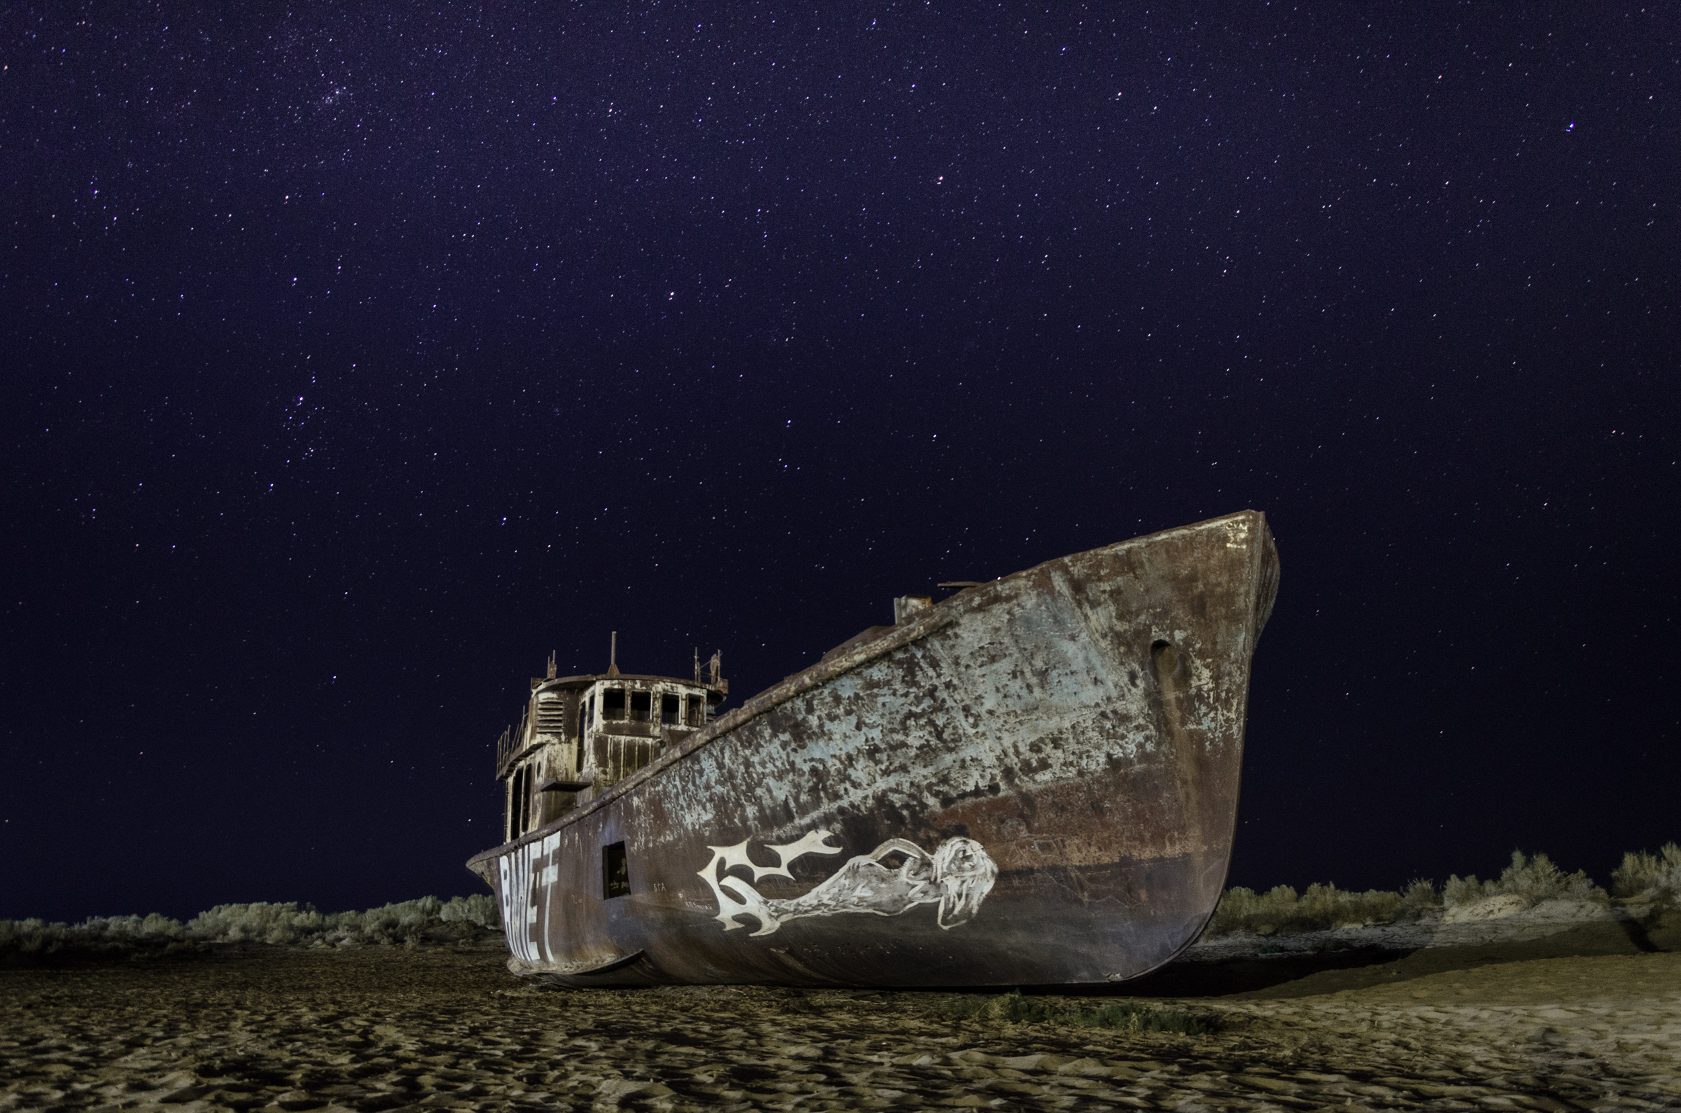


Full itinerary and detailed information about the trip.
Tour to Moynaq, to the shores of the dried-up Aral Sea
BEST CHOICE
BEST PRICES
RELIABLE TEAM

Slide 2

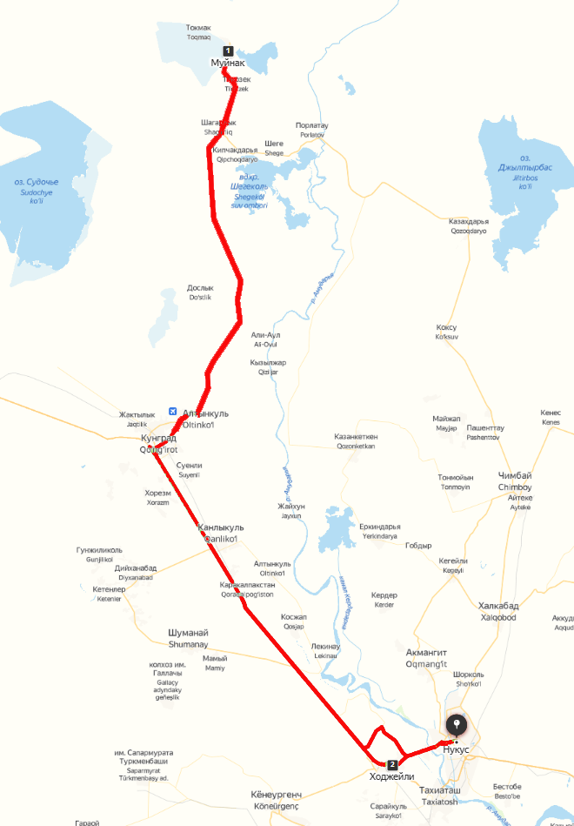

Trip itinerary
Duration:
1 day
Tour season:
Year-round
Total distance:
More than 400 km
Meals:
On request
Transport:
Sedan / Minibus

Slide 3

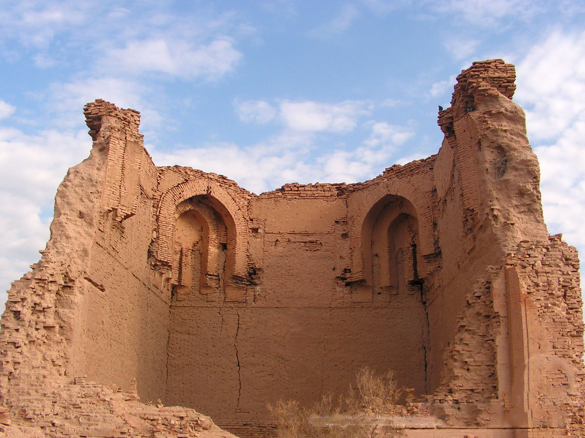
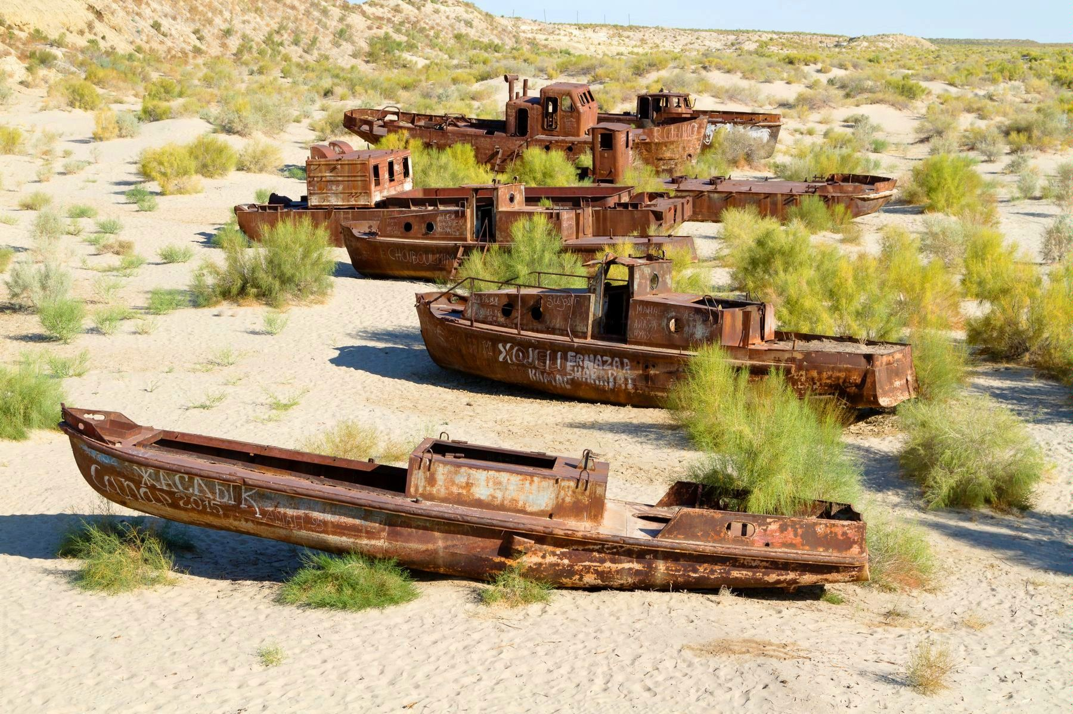
Day 1: Nukus – Muynak – Khodjeli - Nukus
Start point:
Nukus city (Railway Station, Airport, Hotel, etc.)
Meeting with your driver at 09:00 will open the gates to an exciting adventure through lands where history intertwines with majestic nature. Our route is directed towards the town of Moynaq, which, like a lost oasis, was once a thriving port but today is adorned with sand dunes stretching for hundreds of kilometers. This unique journey will begin with a drive through Khodjeyli and Kungrad, where the road becomes a temporary bridge between us and the remarkable trading centers of the Great Silk Road era.
By 12:00, we will reach Moynaq, and our exploration of its history will commence at the Ship Cemetery, where forgotten vessels stand as a monument to past maritime endeavors. We will then immerse ourselves in the richness of local culture at the local museum and dive into the atmosphere of the past through a short documentary film that will recreate Moynaq's life in its golden days.
Lunch at 13:30 will be a unique experience at a local family's guesthouse, where traditional dishes will blend with hospitality, creating a warm and friendly atmosphere. Return to Nukus.
At 17:00, we will stop in Khodjeyli, where history meets stones and buildings. The 14th-century architectural complex "Mizdakhan" will reveal the secrets of the past. The mausoleum of Nazlumkhansulu (XII-XIV century), the Caliph Erejep's mausoleum (XII century) will tell its own story, Shykh Nabi (XIX century), and the ruins of the Gaur-Kala fortress (VI century BCE - IX century CE) from the Zoroastrian era will add a touch of magic to our journey through time.
By 18:00, we will reach the conclusion of our fascinating journey in Nukus, but it will leave behind memories of the greatness and richness of history that will stay with us for a long time.

Slide 4
